Slide 2
Symposium Overview

Slide 3
Objectives of the 2015 Symposium
To engage nations in deeper discussions regarding the role of career guidance in the education and employment sectors and its impact on economic development
To facilitate conversations, awareness and support for youth workforce development initiatives

Slide 4
Overview of the Symposium Content
Big Picture
4 Themes
Catalyst Speakers/Panels/Debate
Synthesis
Workshops
Related Presentations
Country Action Plans

Slide 5
Overview of the Symposium Process
Opportunities for working with similar and diverse countries (both formally and informally)
Traditional and “out of the box” approaches
Exchange, sharing, learning, largesse and laughter
Always keep an eye on the “so what” and your country action plan

Slide 6
Youth Voices What do you think youth in your own country would say?

Slide 7
What’s Going On ?
The Big Picture:
Why Is Youth Unemployment at a Record High?
Sareena Hopkins
Canadian Career Development Foundation
Notes:
Today’s labour market is rife with complexity and anomaly and youth seem to be caught in the eye of the storm. In the immortal words of Marvin Gaye…What’s going on???

Slide 8
Something’s not right
Jobs without people and people without jobs
Skill shortage?
The most educated cohort in history is working for free.
Almost 45% of working adults are working in jobs with some level of precarity
90% of youth 18-24 feel excessive stress because of economic instability and underemployment (SunLife, 2012)
Notes:
We read the headlines and know that we live in a labour market where jobs remain unfilled while unemployment rises.
We hear the endless debates: do we have a skills gap or is it a skills mismatch? Is it all the fault of educational institutions failing to train students to meet labour market needs? Or is it just that Generation Y is too spoiled and expect too much?
We do know that youth are last in the door and first out, they lack the job experience employers demand, they have fewer ties with unions, less access to employment insurance and are more likely to work in precarious employment – or not work at all – and a recent survey suggested that 90% of youth are feeling excessive stress as a result.

Slide 9
The B.A.rista Generation
Notes:
Post-secondary (tertiary) education participation rates have grown as youth try to get the credentials to put them into the knowledge economy – yet more and more of them are shut out from the labour market, stuck in precarious low-wage work and live at or below the poverty rate.
Is it possible that in trying to make sense of it all, we have tended to focus on just half the picture? Much of our research is supply side driven – how to make youth better skilled, better prepared, make better career choices, have better attitudes. There is much more limited discourse on the role of the demand side and how the labour market itself has affected youth, and indeed workers of all ages.

Slide 10
In 15 minutes (!), I’ll ….
Explain how we got to this point
Look at multiple impacts to job quantity and quality
Technology
Financialization
Business practice
Sharing Economy
Describe how this impact youth
Notes:
Labour markets vary considerably both across and within countries and no single model explains what’s really going on…BUT, I want to examine a few key trends that seems to be shaping the labour market reality in a number of OECD countries. Specifically, I want to explore the impact of Technology, Financialization, Business Practices and the Sharing Economy. For this, I’ll be drawing heavily on the work of Tom Zizys and my colleagues Donnalee Bell and Krista Benes.

Slide 11
Impact # 1: Technology

Slide 12
TECHNOLOGY AND THE HOURGLASS LABOUR MARKET
rule makers, sustainers, calculators, technicians and artists
Blue collar, pink collar, service and sales
Notes:
Many of you are no doubt already familiar with the hourglass labour market.
Knowledge workers
At the top of the hourglass, we have a growth of knowledge sector jobs that require post-secondary – these are your rule makers (business, senior management, finance, lawyers), sustainers (those who work in health care, teach or who counsel), calculators (scientist and IT professionals), technicians (those who play a supporting role in admin for a wide variety of sectors and technicians in natural and applied science), and artists (writers, performers, artist and librarians)
Entry Level
There has also been a significant growth of entry level positions at the bottom of the hourglass. These don’t require a PSE credential or significant work experience. They’re blue collar, pink collar, service and sales jobs and these are typically the entry point jobs for youth. These jobs are hard to replace by technology because they require interpersonal skills – i.e. hair dresser, the person who make your latte to order.
Middle Jobs
Then, in between, there is the constricted middle of the hourglass. These jobs require work experience, but not necessarily a PSE degree or diploma…and they have been a shrinking due to outsourcing, computerization and the reduction of manufacturing sector. (A travel agent is a good example; this person has been largely replaced by accessible web sites that allow us to easily book our own travel)
Most seem to agree that this has been a good characterization of the labour market in most OECD countries.

Slide 13
Technology: Change in employment shares by pay level, Europe and United States, 1993-2006
Notes:
We’ve see the hourglass in the distribution of wages: a rise in lower paying and higher paying jobs (depicted in the yellow and blue bars) and a diminishing of the red middle paying jobs.

Slide 14
Technology: Percentage change in employment share of all jobs, by skill content, United States, 1981-2011
Notes:
We’ve also see the hourglass in the distribution of skill content demands, with a rise in demand for non-routine cognitive and non-routine manual roles at the top and bottom of the hourglass and a decline in the routine roles in the middle

Slide 15
Technology Used to Enhance Labour Markets…but this time might be different
Not just routine functions
Speed of transformation
Reduction in job
Notes:
Now you can argue that technology has been displacing workers since the stone age, but in fact it’s aggregate result has historically actually been an increase in jobs, not a decrease.
During the Industrial Revolution, increases in automation displaced some workers, but tended to create the need for more. For example, textile industries reduced the need for cloth weavers, but cloth became much cheaper and people began buying more clothes = all of a sudden, there was an increased demand for designers, seamstresses, tailors and sales clerks
This trend continued with technology often not displacing, but rather changing the nature of certain roles. For example, the introduction of ATMs did not actually result in the disappearance of bank tellers – rather it changed to focus more on marketing bank products
But recently, technology has begun to replace NOT just routine functions, but also non-routine jobs. All of a sudden, technology can scan an MRI and detect the possibility of a tumour. Erik Brynjofsson and Andrew McAfee, professors from MIT, have been arguing for the last year and a half that impressive advances in technology—from improved industrial robotics to automated translation services—are largely behind the sluggish employment growth of the last 10 to 15 years.
Technologies are increasingly being adopted not only in manufacturing, clerical, and retail work but in knowledge sector professions such as law, financial services, education, and medicine.
So going back to the hourglass – while the mid-level jobs have been shrinking because of technology, it seems that new technologies may be also starting to take aim at the top of the hourglass, reducing the number of workers needed there too.

Slide 16
Technology: Case in Point
IN 1960:
$7.6 billion in annual profits (current dollars)
600,000 employees
IN 2015:
$18 billion in quarterly profits
93,000 employees
IN 2012:
Facebook bought Instagram for $1 billion
Instragram had 13 employees
Notes:
You can see this exemplified here.
In the Instagram example, what it means is that profit is shared by fewer and fewer

Slide 17
Notes:
Researchers are suggesting our labour market is seeing an unconscious decoupling of productivity and employment. Starting in 2000, increases in productivity are met with no parallel increase in job creation.

Slide 18
Shape of Things to Come?
Notes:
Some argue that new technologies are encroaching on human skills in an unprecedented way. Unchecked by changes in policy or employment practices, there may be fewer jobs not only in the middle, but also at the top of the hourglass; the bottom may bulge and the size of the overall container may be getting smaller and smaller.

Slide 19
Impact # 2: Financialization

Slide 20
Financialization
Market sets expectations (analysts)
Rather than “retain and invest” → “downsize and distribute”
Rise in CEO compensation, drop in CEO tenure
High frequency trading
These concepts and norms migrate to other businesses, including those not publicly traded
Notes:
Over time, we’ve increasingly seen the prime obligation – and driver behind business decisions – become providing the best return to shareholders over the shortest return period.
As a result, the predictions of market analysts often shape business decisions rather than the other way around and the short-term bottom line trumps long term vision, productivity and sustainability.
The push for quick return on investment results in downsizing and outsourcing and, again, wealth is held by fewer and fewer highly mobile CEOs.
Interestingly, we see the trend of having to demonstrate short-term ROI seep beyond business into other sectors…such as our own!

Slide 21
Tyranny of “ratios”
Notes:
ROI boils down to the simple ratio of return over assets – increasing the numerator and/or decreasing the denominator increases the overall ratio.
Accordingly, employers could of course increase their returns by increasing quality and productivity – but that often demands short-term pain for longer-term gains. Instead, the current trend seems to be to reduce assets by downsizing, contracting out and out-sourcing.

Slide 22
Impact # 3 Business Practices
Notes:
Closely related to financialization – indeed possibly an extension of it – are business practices.

Slide 23
Business Practices: Career Pathways in a 1950s Company
From “Working Better: Creating a High-Performing Labour Market in Ontario” Metcalf Foundation
Notes:
Before the hourglass, most agreed that our labour market looked more or less like a pyramid, with abundant entry points and a fairly linear and predictable progression route.

Slide 24
Business Practices: THE 1950s CORPORATE STRUCTURE
Notes:
In the pyramid, companies commonly held all the functions they needed directly under their control. A widget making company not only hired widget makers, but also hired people to clean the building, landscape around it, feed workers at the company cafeteria, keep the books, service the machinery, do research and development, warehouse and ship the widgets, manage HR and customer service.
This meant that someone could get into the company without expertise in widget making and could potentially move up through hard work and training – which was typically offered by the company.

Slide 25
Business Practices: THE INTEGRATED FIRM NOW BECOMES THE NETWORKED FIRM
Notes:
Today’s company looks quite different. While the core function of widget making might be retained, typically all supporting functions are contracted out – so the employees in those contracted services have limited room for advancement/growth and the Widget making company has no responsibility to those employees, whether their working conditions are decent or their contracts precarious.
Despite a wealth of evidence that employer investments in training pay off financially, we increasingly see a hands off approach by employers seeking short-term relationships with workers who are fully qualified, capable and ready to hit the ground running. We are shifting toward renting a workforce rather than investing in one.

Slide 26
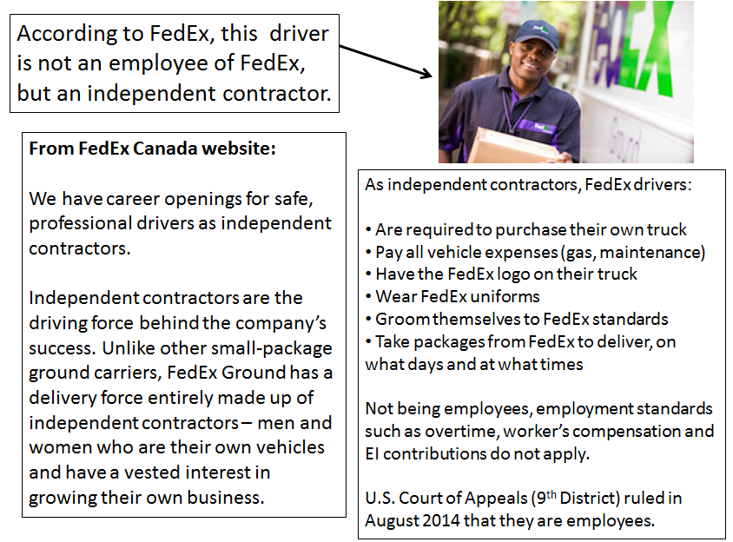
Business Practices: The Age of Precarity
Notes:
Here is a case in point where even the core business has been contracted out – so this FedEx employee is actually not a FedEx employee at all. He is an independent contractor who has bought and maintains at his own cost a FedEx branded truck. He is not protected under employment standards, such as overtime, workers compensation or employment insurance. He is a freelancer rented out by FedEx to deliver their packages for as long as they need him.

Slide 27
Impact # 4 The Sharing Economy
…what happens when technology and financialization have a baby
Notes:
Finally, the offspring of technology and financialization may well be the sharing economy.

Slide 28
The Sharing Economy
Does an employment relationship still matter? Do we desire an economy that is only based on contractual relationships, a sequence of serial freelance gigs?
Notes:
If you’re living in an OECD country, chances are you’ve heard buzz about at least one of these companies. We are seeing considerable growth of the sharing economy. These companies circumvent the employer-employee relationship, with piecemeal work being contracted not by the hour or day, but by the minute.
UBER is an example:
In my country, taxis are often driven by immigrants who rely on this work as they try to have their credentials recognized. Some joke that if you want to find a doctor fast in Canada, jump into the nearest cab. We can debate the ills associated with this form of underemployment, but licenced cab drivers do work under the protection of unions and access employment standards. UBER is changing that. UBER’s “workforce” is dominantly composed of white males who generally have full or other part-time jobs and are UBER drivers as a way of supplementing their income. They have no protection – in fact, their tenure is completely reliant on them being rated positively by their fares – a few negative ratings and they’re out.
It’s convenient and hip – kind of a deviant underground economy that gives us what we need when we need it – but Tom Zizys argues that in fact it shares many of the elements seen in more informal emerging economies where workers struggle to cobble together a living wage without the protection of employment standards or stability. He points out that we have spent the last 100 years trying to build decent employment practices and that the sharing economy threatens to dismantle this.

Slide 29
What does all this mean for youth and for our field?
Is it time to mend our broken relationship with the demand side?
Notes:
So what does all of this mean for youth?
Technology, financialization, business practices and the sharing economy add up to a labour market in which entry-level jobs are no longer stepping stones or even toe-holds. Youth may be able to get entry positions, particularly in the sales and service sector, but they are increasingly over-credentialized and youth often find themselves stuck there, unable to navigate into more stable, better paying and less precarious jobs related to their field of study. Traditional pathways and work search strategies do not apply in this labour market. Nor may traditional ways of thinking about work as a employer-employee relationship. And it may indeed be that the total pot of available jobs is shrinking both in the middle and the top of the hourglass.
As a field, what is our role?
Jaime Oliver argues that obesity and related illness can be traced to our broken relationship with food. We have lost our understanding of where our food comes from and how it impacts our health.
The same might be argued for our field. Do we have a broken relationship with the demand side of our job? How can we help youth to access or create opportunity in this changeable and complex labour market unless we deeply understand it, are actively engaged with the players who influence it and, indeed, become one of those players by advocating for quality opportunities for our clients when we see them dwindling or disappearing.
If we are to truly engage in a relationship with the demand side, this has training, research, practice and policy implications…Implications I hope we’ll be able to consider over these next days...

Slide 30
Thank you! Sareena Hopkins Canadian Career Development Foundation s.hopkins@ccdf.ca

