Slide 2
Technology in Career Practice: Embraced, Avoided, or a Little Bit of Both?
#ICCDPP2015
Presented by:
Dr. Deirdre Pickerell, CHRP, GCDF-i
Vice-President, Life Strategies Ltd.
Writing Lab Coordinator / Instructor, Yorkville University

Slide 3
Setting the Scene

Slide 4
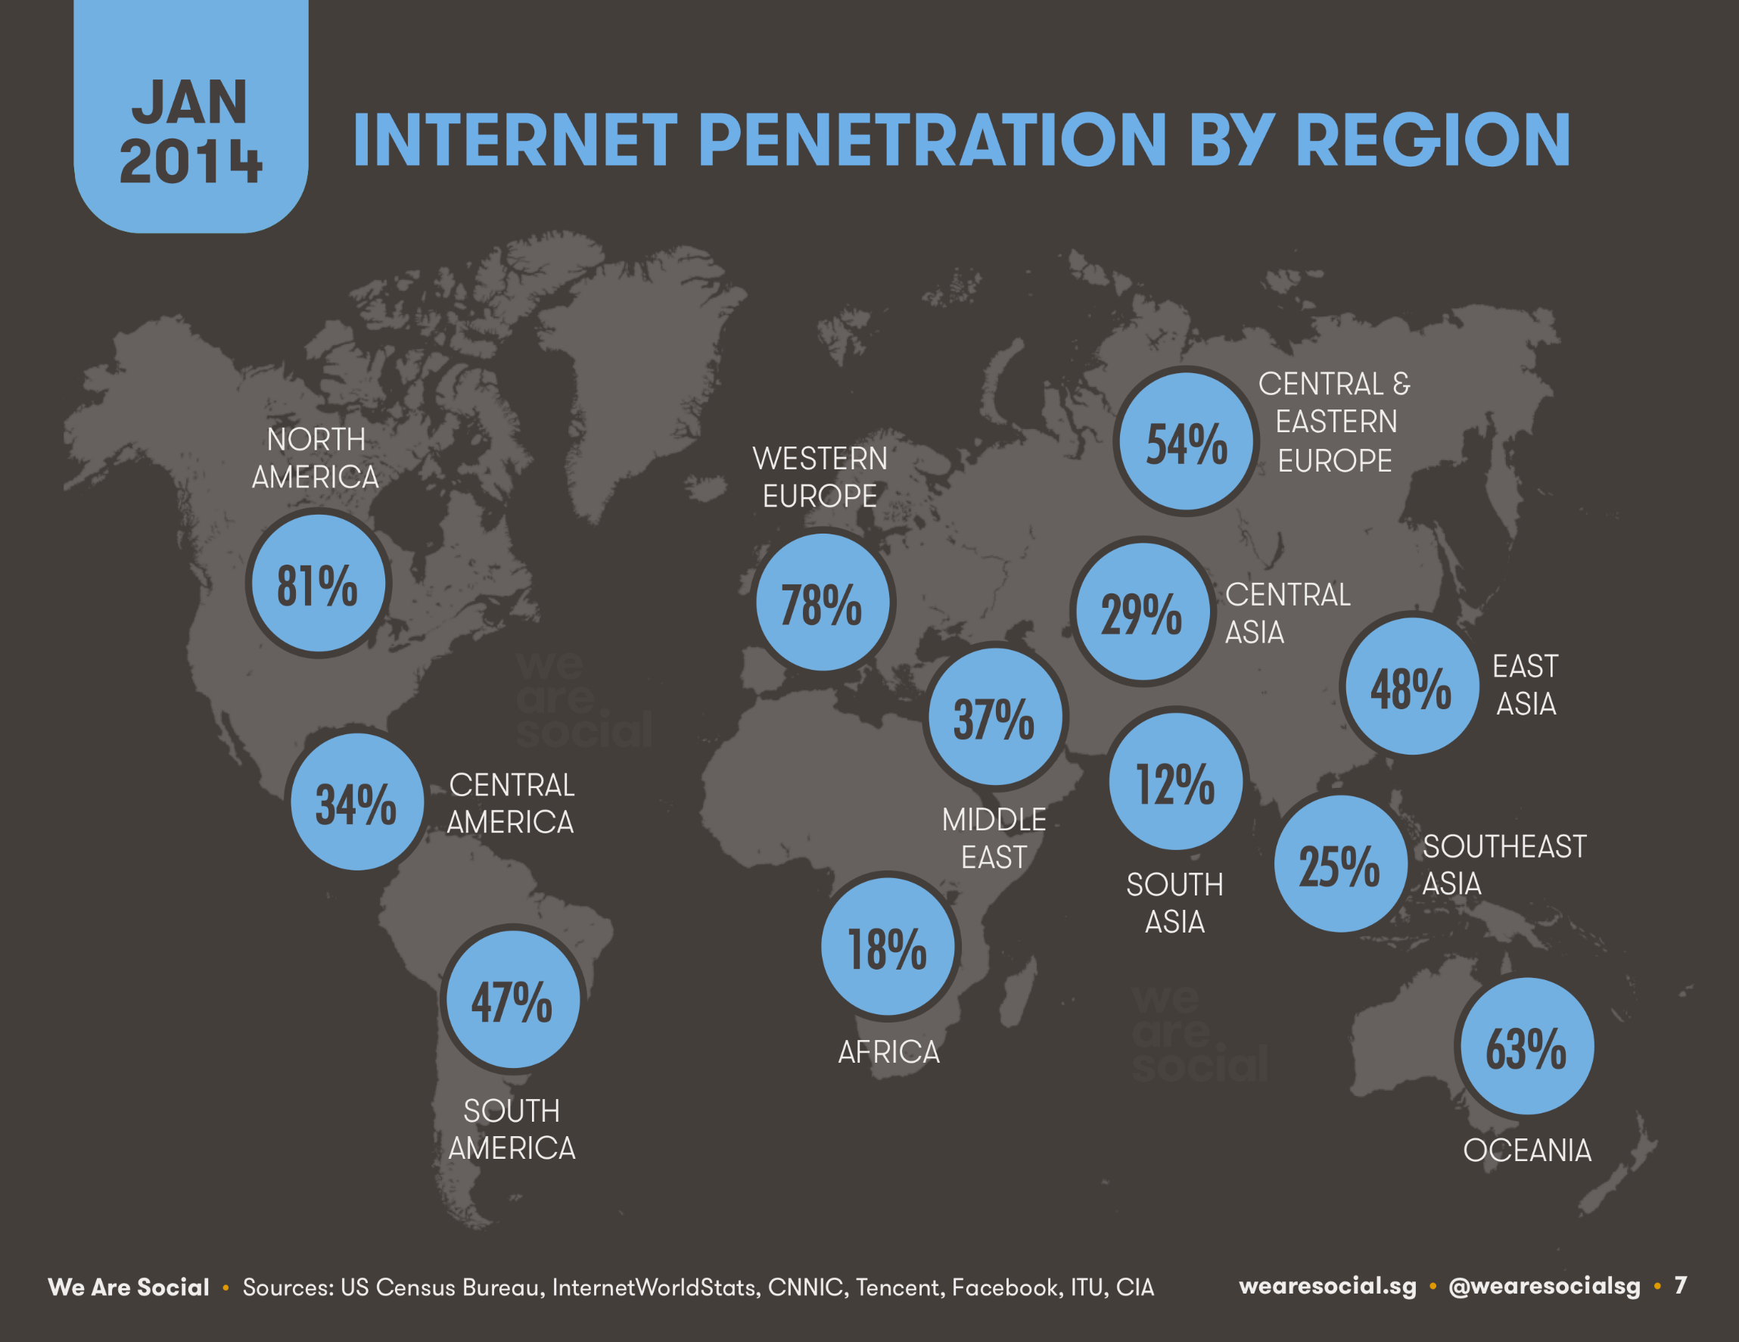
MOBILE
151%
90%
101%
92%
129%
72%
112%
89%
109%
67%
124%
94%

Slide 5
Multiplying 5x faster than us
Facebook is 3rd
More devices than people
12th largest country
Real money for “fake” things
More than previous 5,000 years
Earns $230 million per year
3.5 zeta bytes unique information
Notes:
Facebook is 3rd largest
3.5 x 10 to the 21st

Slide 6
Emerging Technologies and Career Development

Slide 7
Three Key Issues
Research
Practitioners
Ethics

Slide 8
Perhaps the biggest dilemma is technology itself
We seem to be debating the value of technology . . . the should or shouldn’t, instead of identifying how it leverages our potential

Slide 9
Are we a tech-adverse workforce?
My work has been reduced to that of a data entry clerk
Staff are unwilling to access online job aids or training materials or engage in e-learning.
There is a lack of computer/technology skills and strong preference for interpersonal connections.
It has become a tech industry . . .
if you don’t keep up, you’re out

Slide 10
14 codes were reviewed
5 made some reference to technology
1 specifically referred to online services and social media

Slide 11
References
Bimrose, J. Kettunen, J., & Goddard, T. (2014). ICT – the new frontier? Pushing the boundaries of career practice. British Journal of Guidance & Counselling. doi: 10.1080/03069885.2014.975677
Davies Boren, Z. (2014). There are officially more mobile devices than people in the world. Retrieved from: www.independent.co.uk/life-style/gadgets-and-tech/news/there-are-officially-more-mobile-devices-than-people-in-the-world-9780518.html
Kemp, S. (2014). Social, digital, and mobile worldwide in 2014. Retrieved from: http://wearesocial.net/blog/2014/01/social-digital-mobile-worldwide-2014/
All photos purchased from iStock Photography
ICCDP 2015 Symposium Country and Synthesis Papers
International Centre for Career Development and Public Policy. (2011). Transformational technology report

