Slide 2
“The Coming JOBS WAR”
“What the whole world wants is a good job.” (p.10)
“..good jobs are becoming the new currency for all world leaders.” (p.12)
“Jobs are the heart and soul of a nation, the thing that sustains everyone.” (p.22)
“…hope predicts academic success…” (p.134
Jim Clifton,
Chairman of Gallup

Slide 3
The Opportunity Index is an annual composite measure at the state and county levels of economic, educational and civic factors that expand opportunity.
Nations must expand their attention to the “Opportunity” available for their citizens.

Slide 4
Where do we start….
It starts with BUSINESS, a Business with a JOB.
Know business job competencies and plan accordingly. Government can help develop clear career pathways and be the intermediary between business and educators.
Create a Talent Pipeline… See Education as a part of the business supply chain.
Tell your children they don’t need a 4-year or graduate degree when their 1st good job can be a Middle Skills Job that requires more than high school but no more than a 1-2 year degree, diploma or certificate; and, the majority of jobs are Middle Skill Jobs that pay a good living.
Tell them to start anywhere, and go and grow from there... How about a Slaughter House worker, Semi truck driver, Student Assistant, Assistant Dean, Associate University Attorney, Owner of a Law Firm, Community College Dean, and twice a College President. And, never 1 cent of student debt!
Colleges and Universities need to work with secondary schools (K-12) so there is a common definition of “College Ready” and “Career Ready”.

Slide 5
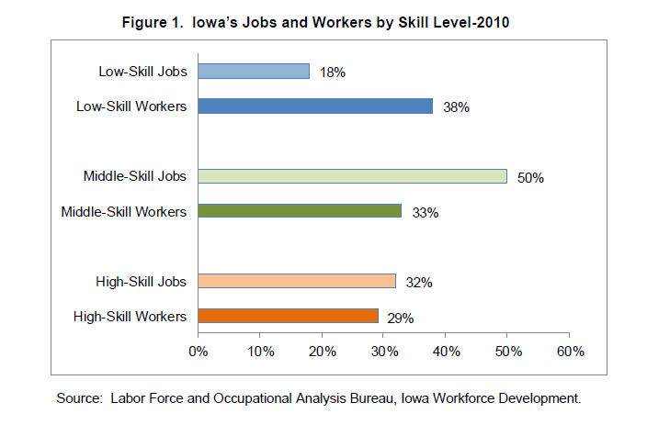
Talking about Middle Skill Jobs…
Down to 12% in Mid-2011
Up to 56%
In Mid-2011

Slide 6
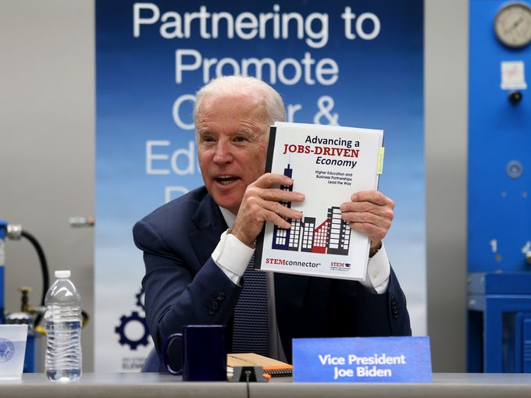
STEM: Science, Technology, Engineering & Math
STEMconnector & “Advancing a JOBS-Driven Economy”
Nearly every good or great job requires some STEM education.
How are you making STEM exciting for YOUR elementary children? That’s where it starts.
When they tell you they want to be a nurse, are you telling them the STEM skills they need to master? And, are you helping them master them?

Slide 7
Who are the Major Players in a Skilled Workforce Development System?
1. Business - What jobs do they have?
2. Business – What competencies do the jobs require?
3. Business – WHO do they or their employees know who might be a good candidate for training?
4. Business – Who is providing paid internships and apprenticeship opportunities so they get the first opportunity to make job offers to talented graduates?

Slide 8
Who are the Major Players in a Skilled Workforce Development System?
5. Government –
a. What support can Government provide for students and educators to make sure that there is a future employee base?
b. Government has the data students, business and educators need to make strategic decisions.
c. Can hold everyone accountable.

Slide 9
Who are the Major Players in a Skilled Workforce Development System?
6. Education –
a. Is Education truly connected to Business, Job Requirements and a partner with business?
b. How do we re-engage drop-outs? There are many and We need to give them a second chance.
c. Are there clear Career Pathways and Completion Tracks for students? They need to see success.
7. Community-Based Organizations, such as United Way – Who provides wrap around services to support individual with barriers get through training and into a career and better life? We need every person who is willing to work, at work!

Slide 10
Can It Be Accomplished?
Government?
- Not a given.
- Should be within your scope of control or influence.
Education?
- If they receive public funding, should take direction.
- Is the training within their mission and scope? Include apprenticeships.
Community-Based Organizations?
- Should be easy to find CBO’s consistent with wrap-around services needed.
Business, Business, Business?
- Aren’t used to having to participate.
- Candidates have always “just been there”.
- You don’t need money… you need their participation to meet their needs.
- Need to have a leadership role and a majority vote on planning groups.

Slide 11
GALLUP-PURDUE Index [Study of more than 30,000 college graduates]
What kind of Education is needed?
“We found out that it really doesn’t matter what type of college you go to – whether it’s public or private, large or small, very selective or not selective. The type of institution has little or no bearing on your long-term life well-being and engagement at work. But how you go to college makes all the difference to your future. Finding a college that provides you with support and experiential and deep learning should be your top goal.”
Who are those Colleges and Universities where you live?

Slide 12
“IF” you have Business, Government, Education and Community-Based Organizations in place and ready, is that enough?
Are advertisers the best source of information for persons looking to plan their future?
Who are the primary and secondary sources for good career information and guidance?
If Gallup says we need “HOPE” to succeed, can someone “HOPE” for something they can’t envision?
Who are the primary and secondary sources for good career information and guidance? Are we giving them the time and tools to be successful?

Slide 13
Integrated Policies: Creating Systems that Work
Tristram Hooley
Professor of Career Education and Head of iCeGS
UNIVERSITY OF DERBY

Slide 15
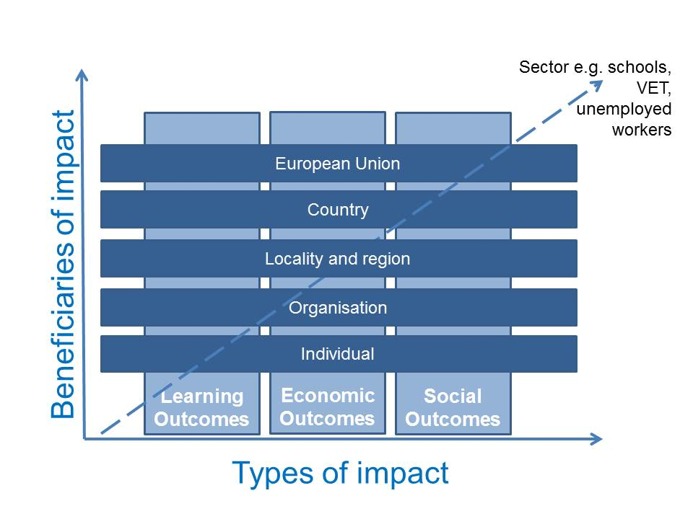
The Impact of Career Guidance

Slide 16
Is the whole greater than the sum of the parts?

Slide 17
Key Concerns:
How ministries and other key stakeholders in countries manage a shared responsibility for the career learning of citizens and forge it into a coherent national strategy and delivery system.
The frequent duplication of efforts that emerge in career learning and development systems that are not integrated or co-ordinated.
As individuals experience their careers over a lifetime they should be able to access support for their careers over the same period.

Slide 18
Effective Practice:
Development of strategies and frameworks
National and regional co-ordination
Integrated service delivery structures
International structures

Slide 19
Key Challenges:
No tradition of career development
National and cultural challenge
Lack of priority by policy makers
Evidence and evaluation

Slide 20
Key Questions:
How well are the roles and shared nature of policy responsibility understood and acted upon?
To what extent is civil society influencing service provision?
How are career development services for young people in your country integrated together?

Slide 21
Tristram Hooley
Professor of Career Education
International Centre for Guidance Studies
University of Derby
http://www.derby.ac.uk/icegs
t.hooley@derby.ac.uk
@pigironjoe
Blog at
http://adventuresincareerdevelopment.wordpress.com

Slide 22
Integrated Policies: Creating Systems that Work
John McCarthy, ICCDPP Director

Slide 23
ILO World Report on Child Labour (2015):
Child labour + limited education = youth vulnerability and greater difficulties in transition to decent work
Links between child labour, youth employment, and engagement in education
Alarming share of employed 15-17 year olds in hazardous work
Comment: social equity, social inclusion, social cohesion, gender equality

Slide 24
USAID: Impact of Youth Workforce Development programs (2013):
Improved employment outcomes for marginalised and less educated
Improved employability skills and life skills
Increased re-engagement with learning
Some impact on policy reform

Slide 25
European Social Partners Framework for Actions for Youth Employment:
Priority actions:
Improving learning: well designed education and training curricula with social partner involvement
Improving transitions (education, training, employment): careers information and guidance
Increasing employment opportunities
Improving entrepreneurial skills (start in school!)

Slide 26
Youth Employment Policy:
Whose responsibility?
Which government departments?
Who are the other actors?
How well do they cooperate?
Youth employment vs youth engagement?

Slide 27
How are Policies Integrated?
National strategies
Human resource development (HRD)
Lifelong learning
Skills development
Labour market transition
Ministries, agencies, other partners involved?
Impact measurement?
Extra challenges for countries with devolved government?

Slide 28
Ensuring Policy Coordination:
NO HRD STRATEGY | NO HRD STRATEGY | HRD STRATEGY | HRD STRATEGY
Lead ministries (education, employment) may or not consult with each other and with other ministries risk to integrated approach to career learning policy | National Career Guidance Forum or similar consultative body/committee platform for consultation, exchange, and collaboration Greater chance of an integrated approach Still challenging! | Career learning and development explicit or implicit in the strategy Managed by a national agency or inter-ministerial committee Greater chance of an integrated approach but implicit needs to be made explicit! | plus a separate lifelong guidance strategy under the umbrella or arising from the HRD strategy plus a national career guidance forum Greatest chance of an integrated approach

Slide 29
Youth Engagement Policy in Scotland:
Cost to economy and society: age 16-24 vs age 24 to 64
Youth engagement a shared government department goal
2014: database of learners established from age 12 onwards managed by the careers learning branch of Skills Development Scotland
Active intervention by the careers learning branch as soon as they become aware of youth disengagement
Customised solutions: e.g. 2 days in high school, plus 2 days in vocational training, plus one day in employment
Career learning as an integral part of Curriculum for Excellence (primary and high schools)

Slide 30
Workshop #5: Integrated Policies: Creating Systems that Work
For each feature, record one idea you’d like to retain for your country.

Slide 31
Conclusions: Integrated Policies

